Slide 1
Foundations of Data Engineering
Damian A. Tamburri, Ph.D.
Data Engineering 2026-2027
Lecture 2 : Virtualization and Cloud Computing

Slide 2
Outline
What is Virtualization?
What is Cloud Computing?
Cloud Service Delivery Models and Deployment Models
Tenancy Models for SaaS Applications
Architecture Decisions in using Hybrid Cloud

Slide 3
What is Virtualization?
Virtualization is the ability to run multiple operating systems on a single physical system and share the underlying hardware resources*
Virtualization uses software to create an abstraction layer over computer hardware that allows the hardware elements of a single computer—processors, memory, storage, and more—to be divided into multiple virtual computers, commonly called virtual machines (VMs).**
Each VM runs its own operating system (OS) and behaves like an independent computer, even though it is running on just a portion of the actual underlying computer hardware. **
Virtualization improves IT throughput and costs by using physical resources as a pool from which virtual resources can be allocated.
*VMWare white paper, Virtualization Overview
** https://www.ibm.com/topics/virtualization

Slide 4
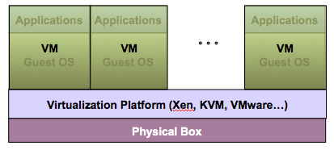
Virtualization Architecture
A Virtual machine (VM) is an isolated runtime environment (guest OS and applications)
Multiple virtual systems (VMs) can run on a single physical system

Slide 5
Hypervisor
A hypervisor, a.k.a. a virtual machine manager/monitor (VMM), or virtualization manager, is a program that allows multiple operating systems to share a single hardware host.
Each guest operating system appears to have the host's processor, memory, and other resources all to itself. However, the hypervisor is actually controlling the host processor and resources, allocating what is needed to each operating system in turn and making sure that the guest operating systems (in virtual machines) cannot disrupt each other.

Slide 6
Benefits of Virtualization
Economies of Scale: Sharing of resources helps cost reduction
Isolation: Virtual machines are isolated from each other as if they are physically separated
Encapsulation: Virtual machines encapsulate a complete computing environment
Hardware Independence: Virtual machines run independently of underlying hardware
Portability: Virtual machines can be migrated between different hosts.

Slide 7
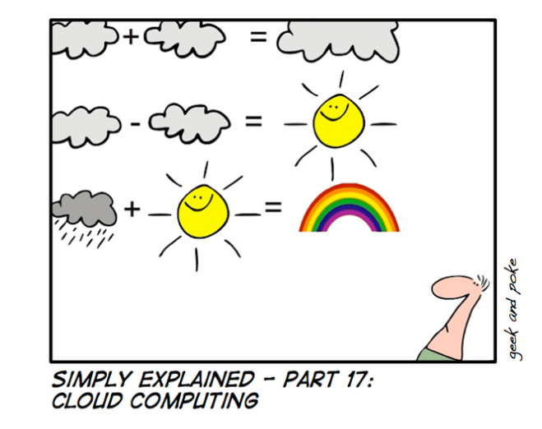
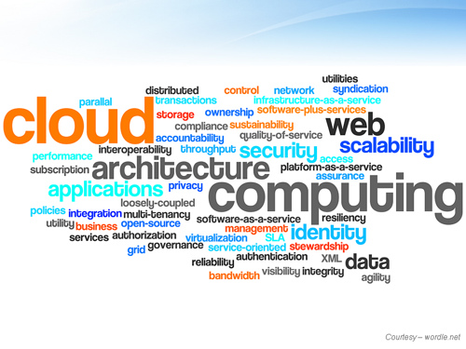
What is Cloud Computing?

Slide 8






Future of Computing
Cloud
Future of Big Data
Cloud
Cloud
Cloud
Multi-Cloud
(containerization
& cloud continuum)
Disruptor:
Virtualization
Web
Client Server
Minicomputer
Mainframe
1960
1970
1980
1990
2000
2010
2020s
Notes:
11/13/26 9:16 AM
SHOW General Session Day 2
Cisco Live! 2009

Slide 9
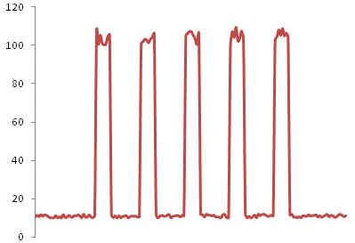
Suppose that you are running Forbes.com
Why pay for capacity weekends, overnight?

Slide 10
Forbes.com’s Solution
Host the web site in Amazon's EC2 Elastic Compute Cloud
Provision new servers every day, and de-provision them every night
Pay just $0.10* per server per hour
  * more for higher capacity servers
Let Amazon worry about the hardware!

Slide 11
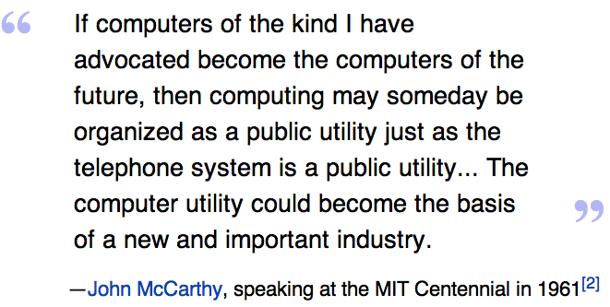


Slide 12
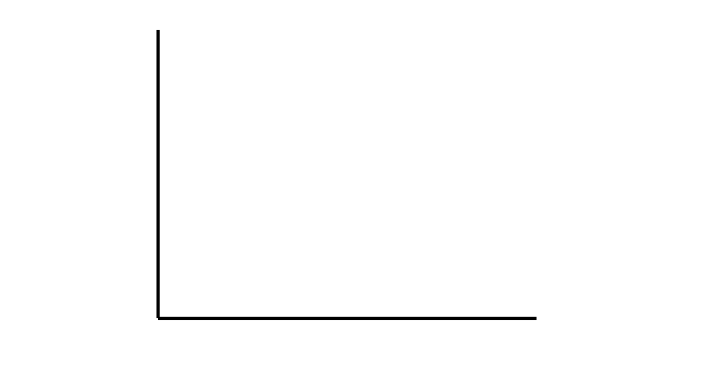
Traditional Infrastructure Model
Forecasted Infrastructure Demand
Capital
Time

Slide 13
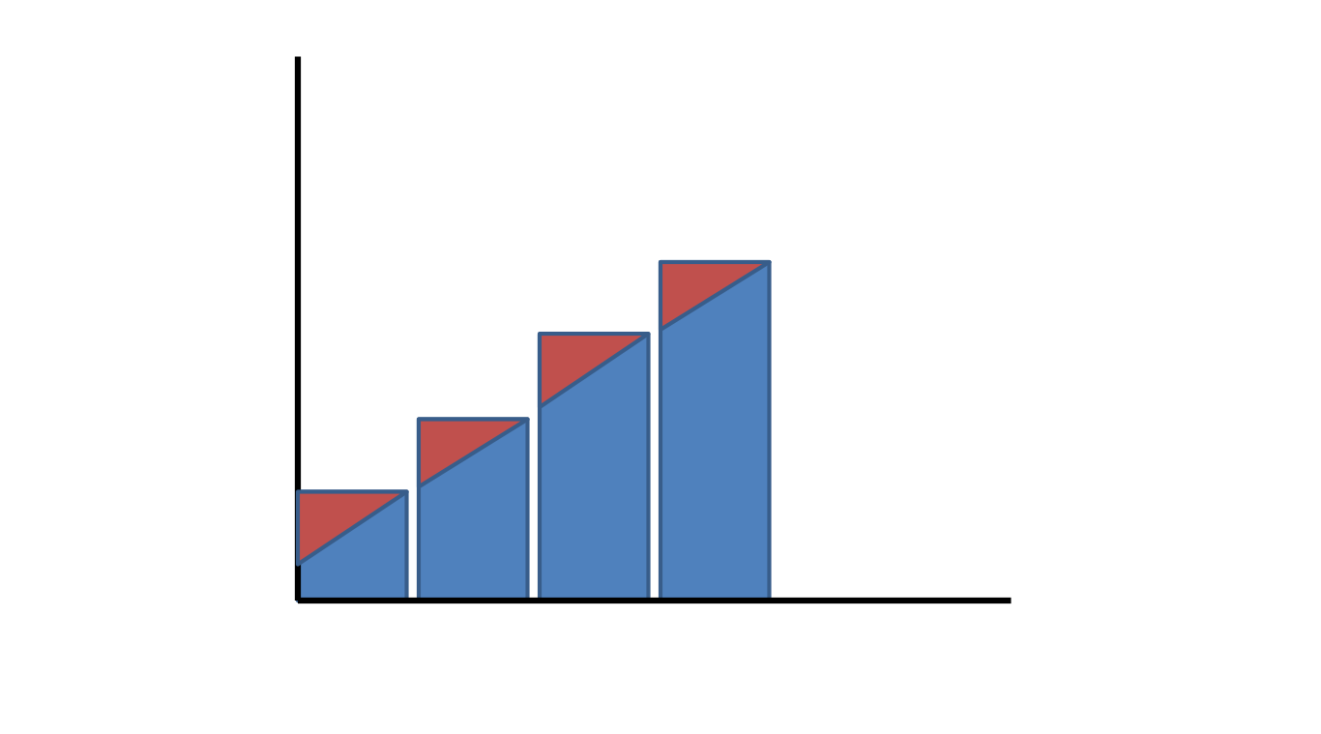
Acceptable Surplus
Forecasted Infrastructure Demand
Surplus
Capital
Time

Slide 14
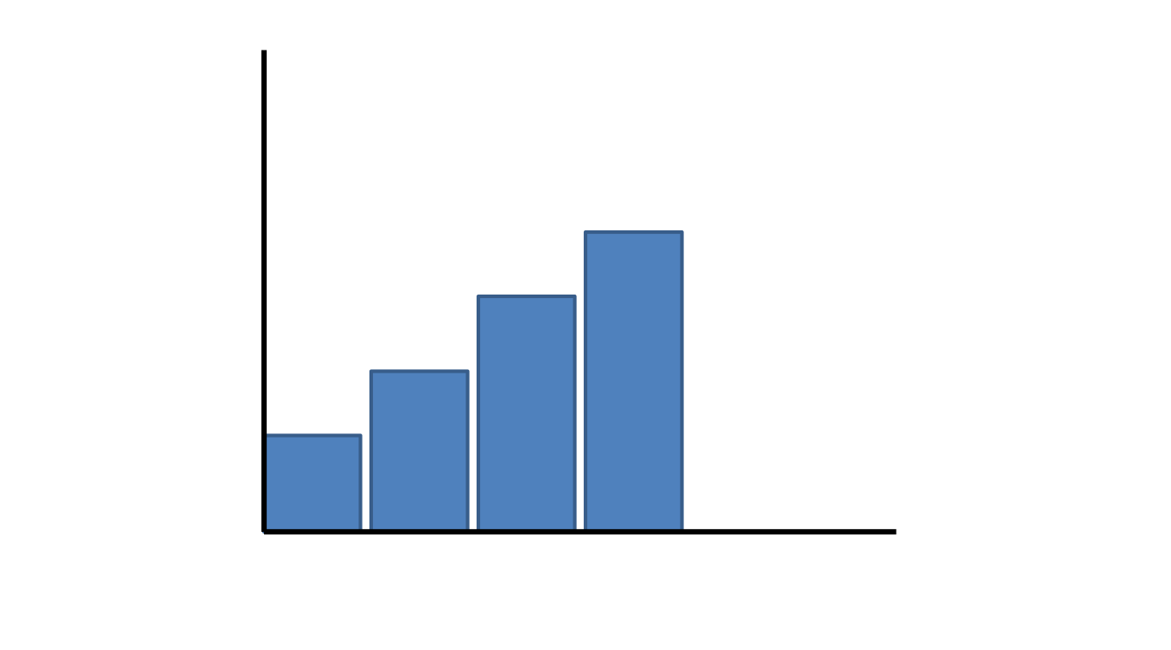
Let’s face the reality…
Capital
Actual Infrastructure Demand
Time

Slide 15
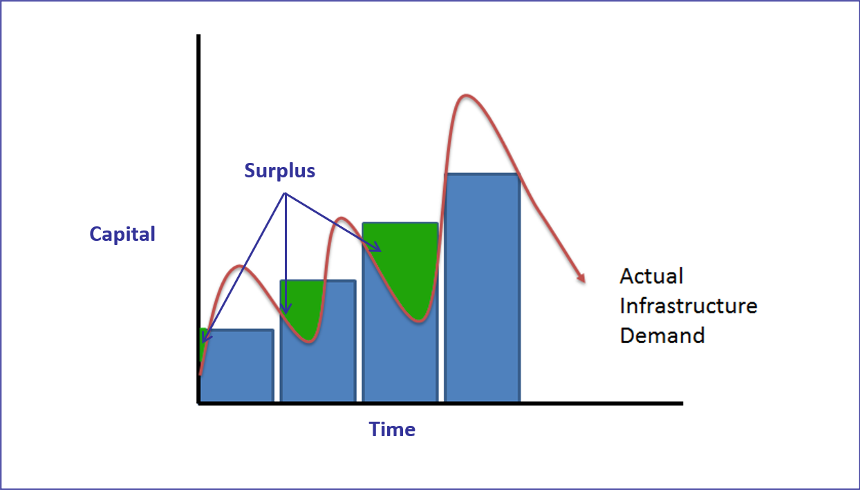
Unacceptable Surplus

Slide 16
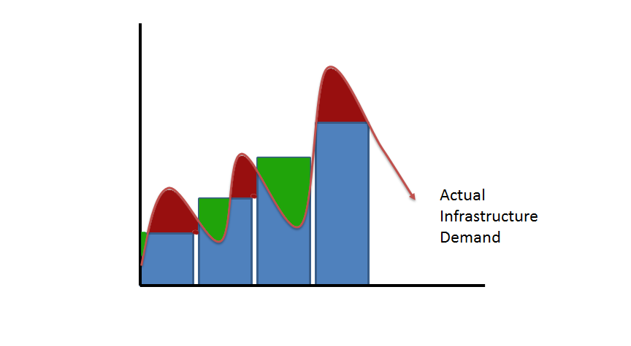
Unacceptable Deficit
Deficit
Capital
Time

Slide 17
Utility Infrastructure Model
Capital
Actual Infrastructure Demand
Time

Slide 18

“The Cloud”
A style of computing where massively scalable (and elastic) IT-related capabilities are provided “as a service” to external customers using Internet technologies.
What’s new?
Acquisition Model: Based on purchasing of services
Business Model: Based on pay for use
Access Model: Over the Internet to ANY device
Technical Model: Scalable, elastic, dynamic, multi-tenant, & sharable
Source: Gartner

Slide 19

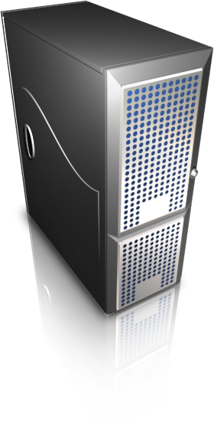

Cloud Computing
“A consumption and on-demand delivery computing paradigm that enables convenient network access to a shared pool of configurable and often virtualized computing resources (e.g., networks, servers, storage, middleware and applications as services) that can be rapidly provisioned and released with minimal management effort or service provider interaction”
[National Institute of Standards and Technology(NIST), USA].
Ubiquitous Network Access
On-demand Self-service
Virtualized Computing Resources
Location Independent Resource Pooling
Pay-per-Use Measured Service
Rapid Elasticity and Provisioning
https://nvlpubs.nist.gov/nistpubs/Legacy/SP/nistspecialpublication800-145.pdf

Slide 20
Characteristics of Cloud Computing
Cloud Services are sourced via networks and are housed “somewhere else.”
Reliability and scalability logic remain hidden, giving the illusion of infinite (elastic) capacity.
These services are programmatically controlled on-demand.
Charges are consumption-based – no upfront investment
Cloud is a Utility-like provisioning of “a Service”:
How to minimize capital expenditure (CAPEX) and ensure operational expenditure (OPEX) – the actual cost of running IT infrastructure - does not grow faster than actual demand of my customers

Slide 21
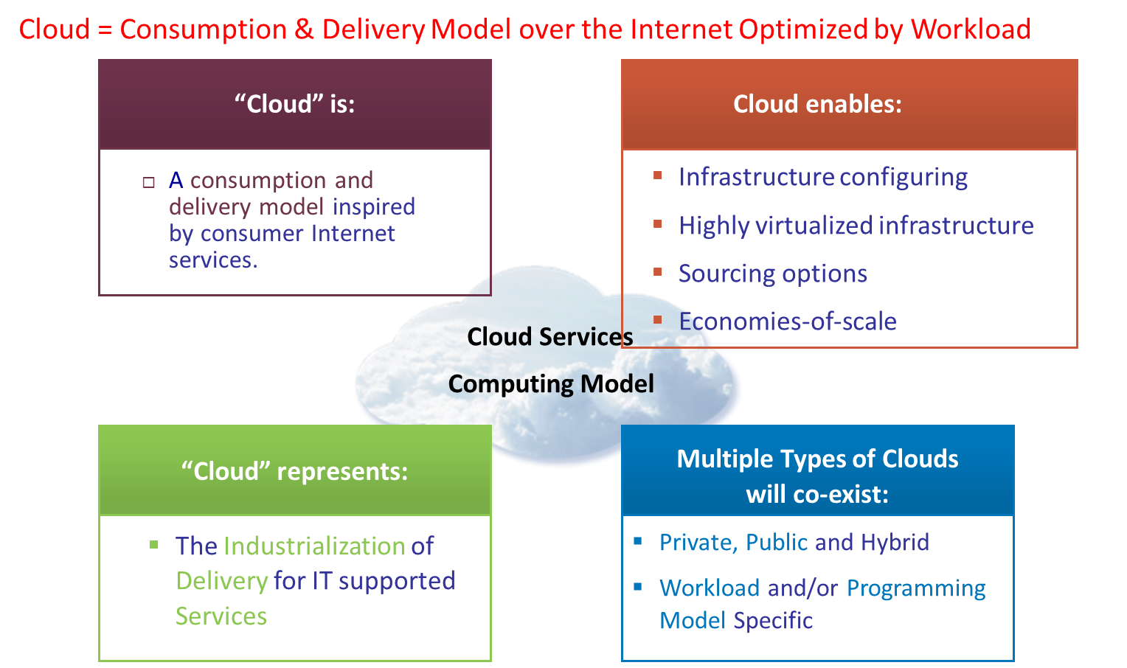
Cloud computing overview
Notes:
Cloud computing is one answer to this crisis of complexity in the data center
The consumer Internet is arguably the biggest infrastructure in operation today and so it is not surprising, that consumer Internet services or consumer clouds, are informing the next generation of enterprise IT delivery.
We think of clouds primarily as a new way of consuming and delivering IT-enabled services.
Many of us use them every day – when we upload our pictures on the Internet for sharing or we download maps for our GPS devices etc. We are not even aware of infrastructure or location.
As we translate this approach to the enterprise, we think three aspects of the cloud model are particularly compelling:
Self-service – a new relationship with IT, which enables the user a degree of freedom in configuring and accessing services and can dramatically reduce labor on the delivery side.
Flexible sourcing options - the idea of more choices and, a hybrid modes of delivery that allows CIOs to optimize costs and qualities of service by work load
And much greater focus on scale – that enables both new economics and new capabilities.
Most people think about “self-service” from the user and user interface perspective. But more interesting to the delivery team is the process standardization behind it…the way we enable the user interaction with a process that used to be served up by a person. This person was someone with control of the process – access, quality of service and client satisfaction.
But we know from a delivery perspective that this model changes a lot more then the interface. It drives the need for a new level of discipline, codification of processes and standardization of the back-office.
Think of the ATM in banking….it started as cash dispensing function. This drove a level of internal standardization, but as networks got connected, it forced standards for networking and security across the industry when you want to access money from one back through the ATM of another. In fact, it became a platform for a whole host of retail transactions.
We know that IT represents a broad, complex set of functions and is vastly more complex and siloed. As a result, this evolution is equally complex. But the opportunity is to drive operational efficiency and improve service quality and satisfaction..
The second key area is sourcing. The cloud model provides a set of new options.
We have been there before – if Intranets and Extranets were about exploiting Internet technology for content, clouds are about computing infrastructure and services.
There are criteria that inform where you compute and how you use the delivery options – Security, control, level of flexibility etc.
One aspect that is often underestimated is the advantage in ‘time-to-market’ – a ‘ready-to-use’ service that can be plugged into an existing infrastructure, seamlessly for the user can be a great option for timing and lower risk.
There are many considerations, but none is more important then the role of the IT organization and managing IT services on both sides of this boundary. We know from experience the cost of letting new technologies and paradigms run wild in the enterprise.
The management system and governance of this hybrid infrastructure will be critical to successfully integrating a cloud in the enterprise.

Slide 22
Why cloud? What’s the value? BIG DATA!
Source: Accenture.
Cost Reduction
Lower infrastructure (capital) costs
Lower maintenance and energy costs
Elasticity / Scalability
Capacity only when you need it
Ability to handle expected or unexpected changes in load
Speed to Serve
Reduction of time to pilot and test projects
Faster availability to customers
High Performance Computing
Avoid provisioning (and paying) for the peak
Increased capacity from your current physical infrastructure
“Infinite” computing capacity on demand
Achieve high business agility

Slide 23
Cloud service delivery models
Cloud service deployment models

Slide 24
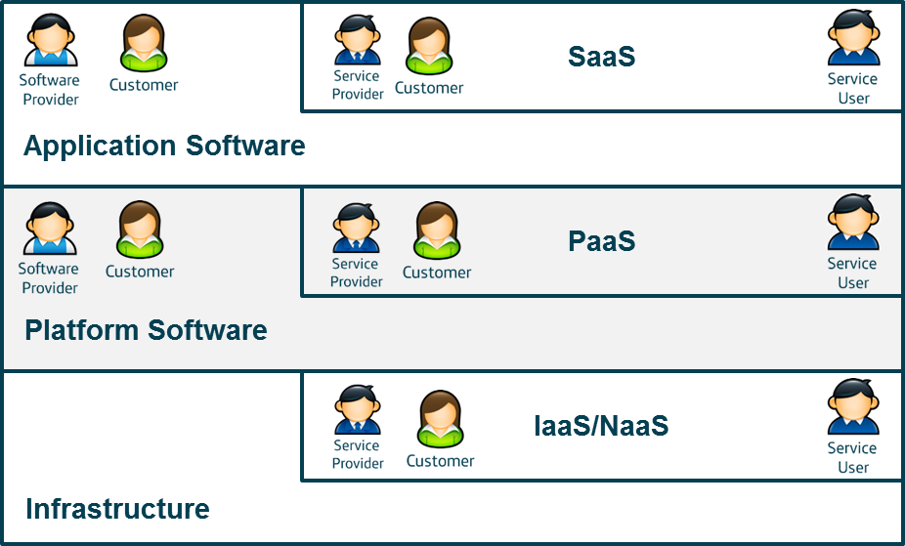
(e.g., SalesForce, Gmail, Gdrive, Canvas, etc)
Cloud Service Delivery Models/ Usage Models
Capability provided to the end user is to use the provider’s applications running on a cloud infrastructure.
(e.g., Google App. Engine, Force.com,
Windows Azure, Apache Stratos)
Capability to deploy onto cloud infrastructure consumer-created or acquired apps created using programming languages, libraries, services, and tools supported by the provider (i.e., programming & execution environment).
(e.g., , Amazon EC2, GCP VMs)
Fundamental computing resources to provision processing, storage, networks, where the consumer is able to deploy software, including OS and applications.

Slide 25
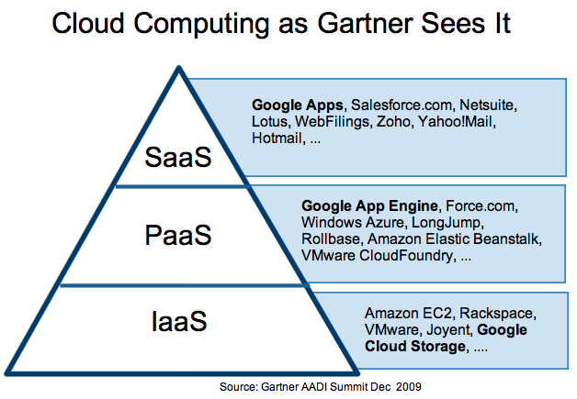

Slide 26
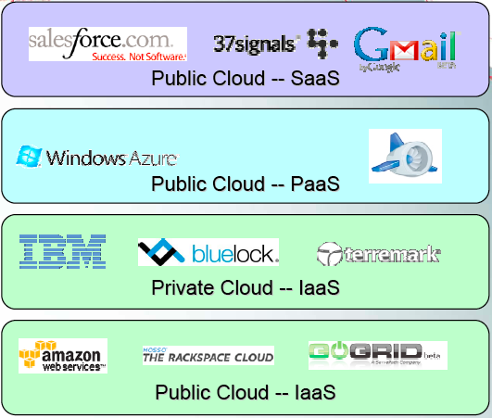
How the cloud is delivered ?
More
Structured
(ease of use)
Less
control
Less
structured
More
control

Slide 27
Cloud Deployment Models
Public Clouds: The cloud infrastructure is available to the general public (anyone wanting to use or purchase cloud services).
Private Clouds: The cloud infrastructure is operated solely for a single organization.
Community Clouds: is available to members of a community. A community can be a set of organizations with similar requirements and goals (e.g., universities).
Hybrid Clouds: is a combination of public and private clouds.
Multi Clouds: is a combination of more than one public cloud.

Slide 28
Public vs. Private Cloud
Public Clouds | Private Clouds
Often depicted as being available to users from a third-party provider, "public" clouds are typically made available via the Internet and may be free or inexpensive to use. There are many examples of these types of clouds, providing services across open, public networks today. One example is Amazon Web Services. | "Private" clouds offer many of the same benefits as "public" clouds but are managed within the organization. These types of clouds are not burdened by network bandwidth and availability issues or potential security exposures that may be associated with public clouds. Private clouds can offer the provider and user greater control, security and resilience.
Greater risks in terms of security, resiliency, transparency and performance predictability (at least in the near term). Key benefit: tremendous elasticity | Less risk – security, resiliency, infrastructure and support processes will not differ significantly from current environment. Better cost effectiveness and agility Move to SLA based service delivery Lower elasticity compared to external clouds
Notes:
Private cloud is a single-tenant environment, meaning all resources are accessible to one customer only—this is referred to as isolated access. Private clouds are typically hosted on-premises in the customer's data center. But, private clouds can also be hosted on an independent cloud provider’s infrastructure or built on rented infrastructure housed in an offsite data center. Management models also vary—the customer can manage everything itself or outsource partial or full management to a service provider.

Slide 29

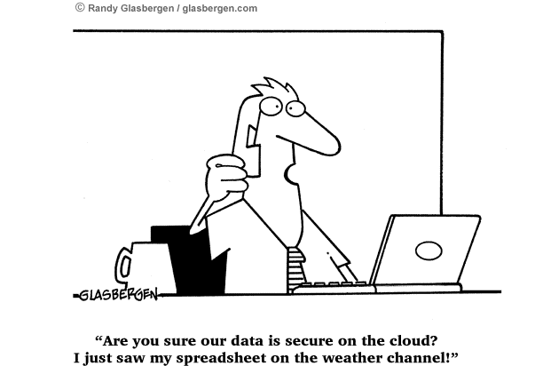
Deployment Model Risk Profile
Public
Community
Private
Higher
Lower
Likelihood of Data Security, Privacy, and Control Breach
- Private environments provide adequate security and privacy
- Service level agreements (SLAs) should exist

Slide 30
Tenancy Models for SaaS Applications

Slide 31
Tenancy Models for SaaS Applications
A customer of a SaaS application is called a tenant. A tenant of a SaaS can be an individual user or a group of users—such as a customer organization.
There are three main tenancy models (how tenants are mapped to application deployment instances) to be used for SaaS applications [1].
  Single tenant
  Mixed tenant
  Multi-tenant
https://canvas.uva.nl/
https://canvas.maastrichtuniversity.nl
https://tilburguniversity.instructure.com
Consider Canvas
[schoolnamehere].instructure.com is the customized URL that the institution claims for its personalized Canvas experience.
[1] https://learn.microsoft.com/en-us/azure/architecture/guide/multitenant/considerations/tenancy-models
Notes:
a music streaming service might support both individual users and families, and it might treat each of these account types differently when it separates them into tenants.

Slide 32
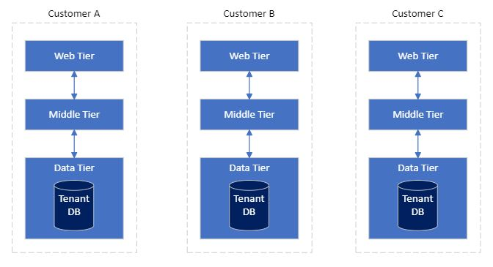
Single Tenant Model
A 3-tier Simple Example
Web Tier - e.g., UI to add and retrieve student grades
Middle Tier – e.g., Application code that adds or retrieves student grades to/from databases
Data Tier – e.g., Database that stores student grades
These are deployments
A single dedicated instance of an application is deployed for each customer.
Notes:
A key difference between tenants and deployments is how isolation is enforced. When multiple tenants share a single deployment (a set of infrastructure), you typically rely on your application code and a tenant identifier that's in a database to keep each tenant's data separate. When you have tenants with their own dedicated deployments, they have their own infrastructure, so it might be less important for your code to be aware that it's operating in a multitenant environment.
Benefits: A key benefit of this approach is that data for each tenant is isolated, which reduces the risk of accidental leakage. This safeguard can be important to some customers that have high regulatory compliance overhead. Additionally, tenants are unlikely to affect each other's system performance, an issue that's sometimes called the noisy neighbor problem. Updates and changes can be rolled out progressively across tenants, which reduces the likelihood of a system-wide outage.
Risks: If you use this approach, cost efficiency is low, because you don't share infrastructure among your tenants. If a single tenant requires a certain infrastructure cost, 100 tenants probably require 100 times that cost. Additionally, ongoing maintenance (like applying new configuration or software updates) will probably be time-consuming. Consider automating your operational processes, and consider applying changes progressively through your environments. You should also consider other cross-deployment operations, like reporting and analytics across your whole fleet. Likewise, be sure to plan for how you can query and manipulate data across multiple deployments.

Slide 33
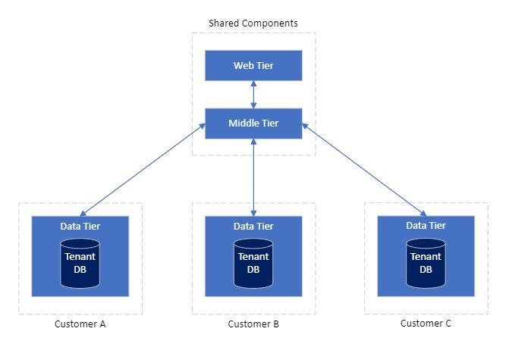
Mix-Tenant Model
One or more parts of an application are deployed as dedicated for each customer, and the rest is shared among all customers. However, each customer has a dedicated data tier and database.
The shared components’ implementation (source code/application logic) must account for tenants’ functional differences.
  Tenants 1 and 2 => features/options A and B
  Tenant 1 => features/options A and C
Notes:
A key difference between tenants and deployments is how isolation is enforced. When multiple tenants share a single deployment (a set of infrastructure), you typically rely on your application code and a tenant identifier that's in a database to keep each tenant's data separate. When you have tenants with their own dedicated deployments, they have their own infrastructure, so it might be less important for your code to be aware that it's operating in a multitenant environment.
Benefits: Horizontally partitioned deployments can help you mitigate a noisy neighbor problem: if you identify that most of the load on your system is caused by specific components then you can deploy separate components for each tenant. For example, your databases might absorb most of your system's load, because the query load is high. If a single tenant sends a large number of requests to your solution, the performance of a database might be negatively affected, but other tenants' databases (and shared components, like the application tier) remain unaffected.
Risks: With a horizontally partitioned deployment, you still need to consider the automated deployment and management of your components, especially the components used by a single tenant.

Slide 34
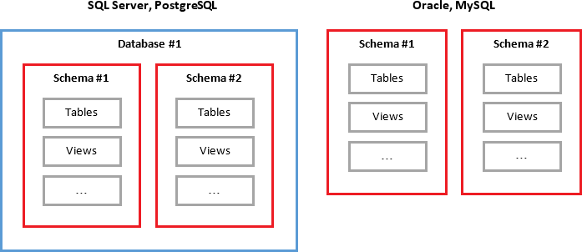
Database Hierarchy
Server (e.g., MySQL Server)
Multiple
Databases
Multiple
Schemas
Different databases may have some differences. For example, in MySQL, the database and schema are the same.
Multiple
Tables

Slide 35
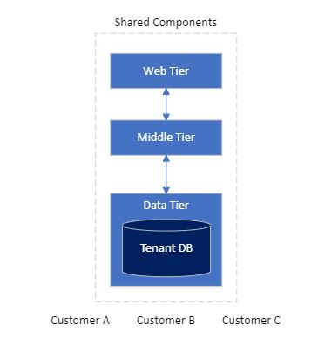
Multi-Tenant Model
A single instance of the application is deployed for all customers and shared amongst them.
The shared components’ implementation (source code/application logic) must account for differences in tenants’ functionalities.
Several database patterns can be used with this model when implementing the data tier.
Database per tenant - uses a separate database for each tenant (but sharing the same server instances)
Single database, separate schema - uses separate tables for each tenant (append tenant ID to a table name)
Single database, shared schema - uses a tenant ID column so that each row has a tenant ID
Notes:
Benefits: This model is attractive because operating a solution that has shared components is less expensive than using individual resources for each tenants. Even if you need to deploy higher tiers or SKUs of resources to account for the increased load, the overall deployment cost is often still lower than the cost of a set of single-tenant resources. Additionally, if a user or tenant needs to move their data to another tenant, you might be able to update tenant identifiers and keys, and you might not have to migrate data between two separate deployments.
Risks:
Be sure to separate data for each tenant, and don't leak data among tenants. You might need to manage sharding data. Additionally, you might need to be concerned about the effects that individual tenants can have on the overall system. For example, if a large tenant tries to perform a heavy query or operation, it might affect other tenants.
Determine how to track and associate your Azure costs to tenants, if doing so is important to you.
Maintenance can be simpler with a single deployment, because you only have to update one set of resources. However, it's also often riskier, because changes might affect your entire customer base.
You might also need to consider scale. You're more likely to reach Azure resource scale limits when you have a shared set of infrastructure. For example, if you use a storage account as part of your solution, as your scale increases, the number of requests to that storage account might reach the limit of what the storage account can handle. To avoid reaching a resource quota limit, you can consider deploying a pool of multiple instances of your resources (for example, multiple AKS clusters or storage accounts). You can even consider distributing your tenants across resources that you deploy into multiple Azure subscriptions.
There's probably a limit to how far you can scale a single deployment, and the costs of doing so might increase non-linearly. For example, if you have a single shared database, when you run at very high scale you might exhaust its throughput and need to pay increasingly more for increased throughput to keep up with your demand.
Benefits: Horizontally partitioned deployments can help you mitigate a noisy neighbor problem: if you identify that most of the load on your system is caused by specific components then you can deploy separate components for each tenant. For example, your databases might absorb most of your system's load, because the query load is high. If a single tenant sends a large number of requests to your solution, the performance of a database might be negatively affected, but other tenants' databases (and shared components, like the application tier) remain unaffected.
Risks: With a horizontally partitioned deployment, you still need to consider the automated deployment and management of your components, especially the components used by a single tenant.
z

Slide 36
Multi-Tenant Data Model : Database Per Tenant
tue
uvt
Tenants
SQL query to get the information about all students from Tue?
tue_DB
uvt_DB
student
student
Use database tue_DB
SELECT * FROM student
Tables
Shared Database Server
image credit: https://thwack.solarwinds.com/products/sql-sentry/b/news/posts/introduction-to-sql-server-multi-tenancy-part-2

Slide 37
Multi-Tenant Data Model: Shared Database, Separate Schema (Tables)
tue
uvt
Tenants
SQL query to get the information about all students from Tue?
DB_1
student_tue
Tables
use database DB_1
select * from student_tue
student_uvt
Shared Database Server
image credit: https://thwack.solarwinds.com/products/sql-sentry/b/news/posts/introduction-to-sql-server-multi-tenancy-part-2

Slide 38
Multi-Tenant Data Model: Shared Database, Shared Schema (Tables)
Tenants
tue
Patients IDs and names
uvt
SQL query to get the information about all students from Tue?
DB_1
Tenant_ID | ID | Name
1 | 334334 | Jane
2 | U4345 | Alice
2 | U6565 | Robin
1 | 344354 | Robert
Tables
student
use database DB_1
SELECT * FROM student WHERE Tenant_ID=1
Shared Database Server
Tenant ID 1 – Hospital1
Tenant ID 2 – Healthcare2

Slide 39
Compare Tenancy Models
Measurement | Single Tenant | Mixed | Multitenant
Scale | Medium | High | Very High
Tenant isolation | Very High | High | Low
Cost per tenant | High | Medium | Low
Operational complexity | Low-High - Individually simple, complex at scale. | Low-Medium - Need to address complexity at scale. | Low-High - Individual tenant management is complex, low for many/all
Scale: The number of concurrent customers (or tenants) the application can service.
Tenant isolation: The degree to which customers' data and performance are separated from other customers.
Cost per tenant (for the provider): The relative amount it costs to run a single customer's tenant.
Operational complexity (for the provider): The complexity of achieving operational tasks like automation, monitoring, maintenance, application deployments, and disaster recovery.
Patikirikorala, T., Kumara, I., Colman, A., Han, J., Wang, L., Weerasiri, D., & Ranasinghe, W. (2012, November). Dynamic performance management in multi-tenanted business process servers using nonlinear control. In International Conference on Service-Oriented Computing (pp. 206-221). Berlin, Heidelberg: Springer Berlin Heidelberg.
Kumara, I., Han, J., Colman, A., & Kapuruge, M. (2016). Software-defined service networking: performance differentiation in shared multi-tenant cloud applications. IEEE Transactions on Services Computing, 10(1), 9-22.
Notes:
The level of isolation affects many aspects of your architecture, including the following:
Security. If you share infrastructure among multiple tenants, you need to be especially careful not to access data from one tenant when you return responses to another. You need a strong foundation for your identity strategy, and you need to consider both tenant and user identity in your authorization process.
Cost. Shared infrastructure can be used by multiple tenants, so it's less expensive.
Performance. If you share infrastructure, your system's performance might suffer as more customers use it, because the resources might be consumed faster. Performance issues can be exacerbated by tenants with unusual usage patterns.
Reliability. If you use a single set of shared infrastructure, a problem with one component can result in an outage for all of your tenants.
Responsiveness to individual tenant needs. When you deploy infrastructure that's dedicated to one tenant, you might be able to adapt the configuration for the resources to that specific tenant's requirements. You might even consider this capability in your pricing model, allowing customers to pay more for isolated deployments.
Disaster recovery is the process an organization uses to quickly restore IT infrastructure, data, and business operations after a disruptive event, such as a cyberattack, natural disaster, hardware failure, or human error

Slide 40
Architectural Decisions in Using Hybrid Cloud
Cloud
On-premise
Notes:
Hybrid cloud architectures split workloads across the cloud and on-premises environments. Generally, these workloads interact to do something useful. Both environments are managed in a unified way.

Slide 41
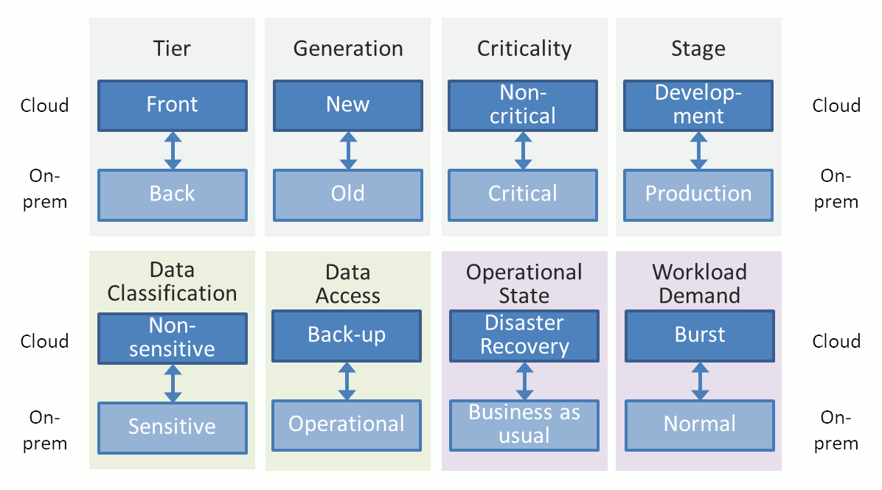
How to Split Workload
The key architectural decision of the hybrid cloud is how to split the workloads (i.e., applications/systems used by the organization).
Ref: https://architectelevator.com/cloud/hybrid-cloud/ (from Gregor Hohpe)

Slide 42
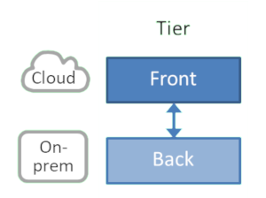
How to Split Workload (Cont’d)
Isolating and migrating frontend applications tends to be less complex than migrating backend applications, which might have complex dependencies.
Frontend applications generally do not store personal data.
Many front-end applications are subject to frequent changes, which can be handled using tools such as CI-CD (from the Cloud).
Frontend applications generally face more workload surges and thus can take advantage of the elastic scaling of the cloud
Tier: Frontend vs. Backend
Notes:
Frontend and backend are two critical aspects of any application. The frontend is what your users see and includes visual elements like buttons, checkboxes, graphics, and text messages. It allows your users to interact with your application. The backend is the data and infrastructure that make your application work. It stores and processes application data for your users.

Slide 43
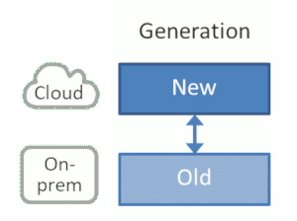
How to Split Workload (Cont’d)
The new applications can be designed as cloud-native applications that can utilize the cloud resources efficiently.
Generation: New vs. Old
Cloud-native is the software approach of building, deploying, and managing modern applications in cloud computing environments.
Cloud-native applications are software programs that consist of multiple small, interdependent services called microservices.
https://aws.amazon.com/what-is/cloud-native/
Notes:
Again, several reasons speak for this type of split:
Modern components are more likely to use modern tool chains and architectures, such as micro-services, continuous integration (CI), automated tests and deployment, etc. Hence they can take better advantage of cloud offerings.
Modern components are more likely to run in containers and can thus utilize higher-level cloud services like managed Kubernetes or serverless environments.
Modern components are more likely to be well-understood and tested, reducing the migration risk.
Again, there are a few things to consider:
Splitting by new vs old may not align well with the existing systems architecture, meaning it isn’t hitting a good seam. For example, splitting highly cohesive components across data center boundaries will likely result in poor performance.
Unless you are in the process of replacing all components over time, this strategy doesn’t lead to a “100% in the cloud” outcome.
Overall this is a good approach if you are developing new systems - ultimately new will replace old

Slide 44

How to Split Workload (Cont’d)
Criticality: Non-critical vs. Critical
Move/Migrate non-critical applications to the public cloud first (e.g., the user Q/A forum can be deployed in the cloud while the product website can be deployed on-premises)
“Failing fast” and learning along the way
Notes:
“Failing fast” and learning along the way makes sense:
Skill set availability is one of the main inhibitors of moving to the cloud - stuff is never as easy as shown in the vendor demos. Therefore, starting small and getting rapid feedback builds much needed skills in a low-risk environment.
Smaller applications benefit from the cloud self-service approach because it reduces or eliminates the fixed overhead common in on-premise IT.
Small applications also give you timely feedback and allow you to calibrate your expectations.
While moving non-critical applications out to the cloud is a good start, it also has some limitations:
Cloud providers generally offer better uptime and security than on-premises environments, so you’ll likely gain more by moving critical workloads.
While you can learn a lot from moving simple applications, they may not have the same security, up-time, and scalability requirements as subsequent workloads. You therefore need to be cautious to not under-estimate the effort of a full migration.

Slide 45

How to Split Workload (Cont’d)
Application Lifecycle: Development vs. Production
We can run the toolchain, test, and staging environments in the cloud while keeping the production environment on-premises, e.g., due to regulatory constraints.
Build and test environments rarely contain real customer data.
Development, test, and build environments are temporary in nature.
Notes:
Shifting build and test environments into the cloud is a good idea for several reasons:
Build and test environments rarely contain real customer data, so most concerns around data privacy and locality don’t apply.
Development, test, and build environments are temporary in nature, so being able to set them up when needed and tearing them back down leverages the elasticity of the cloud and can cut infrastructure costs by a factor of 3 or more: the core working hours make up less than a third of 168 hours in a week. Functional test environments may even have shorter duty cycles, depending on how quickly they can spin up.
Many build systems are failure tolerant, so you can shave off even more Dollars by using preemptible / spot compute instances.
You might have guessed that architecture is the business of trade-offs, so once again we have a few things to watch out for:
Splitting your software lifecycle across cloud and on-premises results in a test environment that’s different from production. This is risky as you might not detect performance bottlenecks or subtle differences that can cause bugs to surface only in production.
If your build chain generates large artifacts you may face delays or egress charges when deploying those to your premises.
This option may be most popular for development teams that are restrained from running production workloads in the cloud but still want to take as much advantage of it as possible.

Slide 46
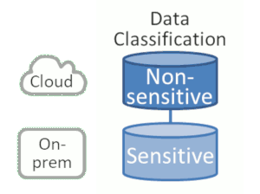
How to Split Workload (Cont’d)
Data Classification: Non-sensitive vs. Sensitive
Move non-sensitive data to the cloud while keeping sensitive data on-premises
However, protecting on-premises environments from sophisticated attacks and low-level (e.g., CPU-level) exploits has become difficult (lack of cybersecurity experts, tools, etc.)
Notes:
As data classification can be the hurdle for moving apps to the cloud, a natural split would be to move non-sensitive data to the cloud while keeping sensitive data on premises. Doing so has some distinct advantages:
It complies with common internal regulations related to data residency as sensitive data will remain on your promises and isn’t replicated into other regions.
It limits your exposure in case of a possible cloud data breach.
However, the approach is rooted in assumptions that don’t necessarily hold true for today’s computing environments:
Protecting on premises environments from sophisticated attacks and low-level exploits has become a difficult proposition. For example, CPU-level exploits like Spectre and Meltdown were corrected by some cloud providers before they were announced - something that couldn’t be done on premises.
Malicious data access and exploits don’t always access data directly but often go through many “hops”. Having some systems in the cloud while your sensitive data remains on premises doesn’t automatically mean your data is secure. For example, one of the biggest data breaches, the Equifax Data Breach that affected up to 145 million customer records had data stored on premises.
Hence, while this approach may be suitable to getting started in face of regulatory or policy constraints, use it with caution as a long-term strategy.

Slide 47
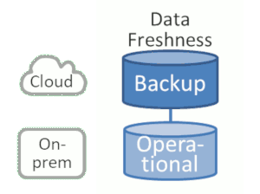
How to Split Workload (Cont’d)
Data Freshness: Back-up vs. Operational
Not all the data is accessed by applications all the time.
Store historical records or data back-ups in the cloud.
Notes:
Archiving data in the cloud makes good sense:
Backing up and restoring data usually occurs separate from regular operations, so it allows you to take advantage of the cloud without having to migrate or re-architect applications.
For older applications, data storage cost can make up a significant percentage of the overall operational costs, so moving some of this to the cloud can give you instant cost savings.
For archiving purposes, it’s good to have data in a location separate from your usual data center.
Alas, it also has limitations:
Data recovery costs can be high, so you’d only want to move data that you rarely need.
The data you’d want to back up likely contains customer or other proprietary data, so you might need to encrypt or otherwise protect that data, which can interfere with optimizations such as data de-duplication.
Still, using cloud backup is a good way for enterprises to quickly start benefiting from the cloud.

Slide 48
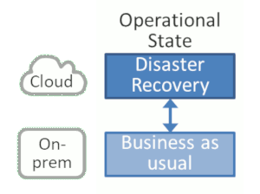
How to Split Workload (Cont’d)
Operational State: Disaster vs. BAU (Business As Usual)
When the application becomes unavailable due to a temporary failure of the on-premise server(s), use the public cloud to run the same application temporarily.
Here, no workloads run in the cloud under normal operational conditions.
Cloud usage is temporary, making good use of the cloud’s elastic billing approach.
Notes:
this approach may be most suitable for compute tasks that don’t require a lot of data. For example, for an e-commerce site, you could allow customers to place orders even if the main site is unavailable by picking from a (public) catalog and storing orders until the main system comes back up. It’ll like beat a cute 404 or 500 page.

Slide 49
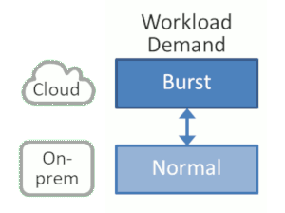
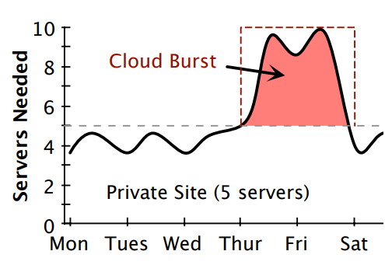
How to Split Workload (Cont’d)
The enterprise uses its own private resources for the majority of its computing but then “bursts” into the cloud when local resources are insufficient.
Keep a fixed capacity on-premises and temporarily extend into the cloud when additional capacity is needed.
Workload Demand: Burst vs Normal Operations
Use the resources from on-premise and cloud simultaneously
ref: https://www.usenix.org/system/files/conference/atc12/atc12-final57.pdf
Notes:
Again, you gain some desirable benefits:
The cloud’s elastic billing model is ideal for this case as short bursts are going to be relatively cheap.
You retain the comfort of operating on premises for most of the time.
But there’s reasons that people don’t talk about this option quite as much anymore:
Again, you need access to data from the cloud instances . That means you either replicate the data to the cloud, which is likely what you tried to avoid in the first place, or your cloud instances need to operate on data that’s kept on premises, which likely implies major latency penalties.
You need to have an application architecture that can run on premises and in the cloud simultaneously under heavy load – not a small feat.
This option likely works best for compute-intensive workloads, e.g. simulations. It’s also a great fit for one-time compute tasks where you rig up machinery in the cloud just for one time.

Slide 50
Recap & Questions?
We discussed the key concepts of cloud computing & Data-Intensive Computing
We discussed two important advanced architectural concerns related to cloud applications
  (Data) Tenancy models
  Data Cloud-on-premises workload split

